Slide 1

2222222222222222222222222222222222222222222222222
Capstone Project
On Hotel Booking
AI

Slide 2
Capstone Project-1
Hotel Booking Analysis
Team Members
Deepak Kumar Gautam
Shivangi Mishra
Saksham Tripathi
Bindu Kovvada
Satyajit Sahoo

Slide 3

Flow of Presentation
Agenda
Data Summary
Cleaning of Dataset
Data Visualization
Inferences
Conclusion

Slide 4
Agenda
Agenda is to discuss the given problem statement i.e., Analysis of several factors influencing hotel bookings in the given hotel booking dataset.
APPROACH:
Hotel booking dataset
Data Summary
Cleaning of Dataset
Analysis and Interpretation

Slide 5
Data Summary
Data set name:
Hotel Booking Database that contains booking information for a city hotel and a resort hotel of various countries from 2015 to 2017.
Data shape:
Rows - 119390
Columns - 32

Slide 6
Columns used:
hotel - name of hotel whether City Hotel or Resort Hotel
is_canceled –(0 or1) Indicates whether booking was cancelled or not.
lead_time – The time between reservation and actual arrival.
arrival_date_month - Month of arrival date
arrival_date_week_number – Week number of year for arrival date
arrival_date_day_of_month – Day of arrival date
stays_in_weekend_nights – Number of weekend nights the guest stayed or booked to stay at the hotel.
Stays_in_week_nights : Number of week nights the guest stayed or booked to stay at the hotel.

Slide 7
adults : Total number of adults in hotel
children : Total number of children in hotel
babies : Total number of babies in hotel
meal : Type of meal booked i.e. Bed & Breakfast (BB), Half Board (HB), Full Board (FB), Undefined contain no meal package
country : Country of customers
market segment : A group of people who share one or more common characteristics used for business
distribution_channel : Chain of business through which a service passes until it reaches the final buyer
previous_cancellations – (0 or 1)previous cancellation by customer
previous_booking_not_canceled- confirmed booked by customer

Slide 8
reserved_room_type – Type of Room booked
assigned_room_type – Type of Room assigned/alloted
booking_charges – booking charges we charged
deposit_type – No Deposit, Non Refund, Refundable
agent- ID of travel agency
company- ID of the company
days_in_waiting_list – Number of days in waiting
adr- Average daily rate
required_car_parking_space – Number of car parking spaces required
total_of_special_request – Number of special request requested
reservation_status - Canceled, Check out
reservation_status_date – Canceled / check out
is_repeated_guest –(0 or 1) contain data of repeated guest
customer_type – Type of customer Contract / Group / Transient

Slide 9
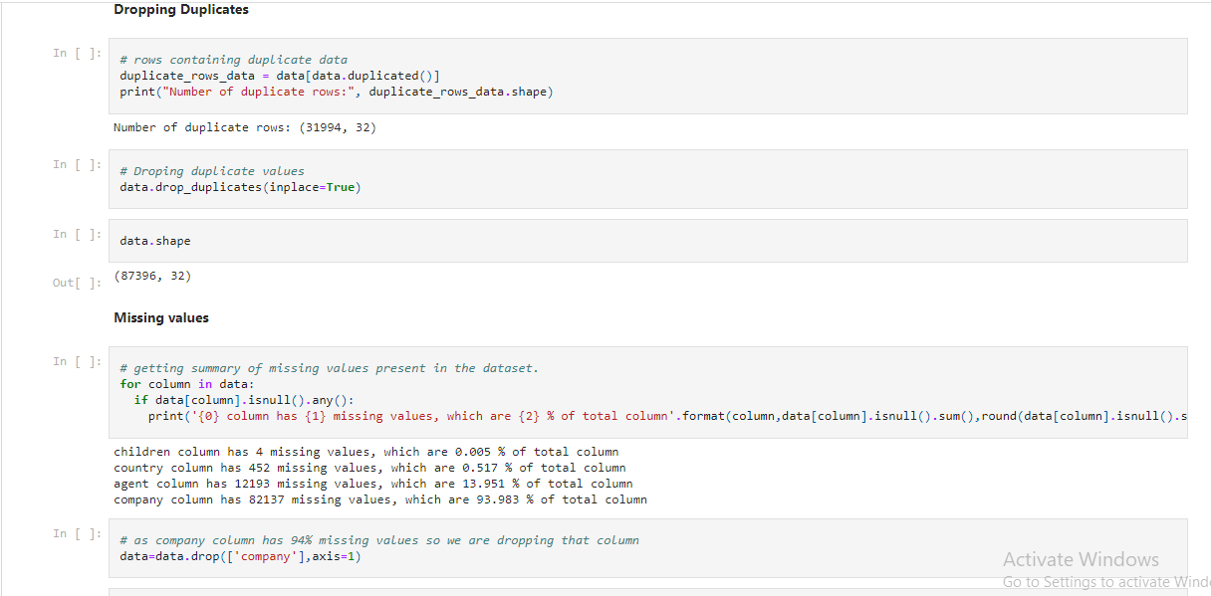
Cleaning of Dataset

Slide 10
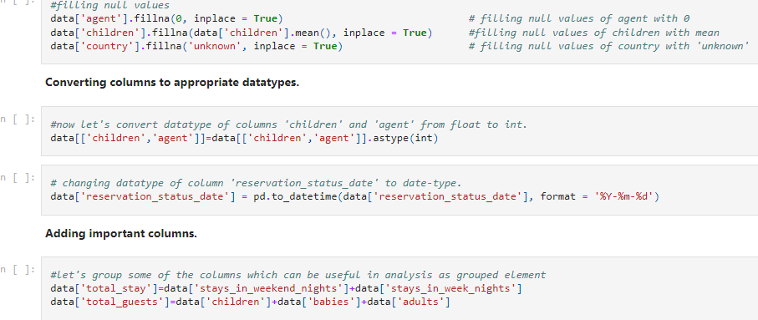
Cleaning of Dataset

Slide 11
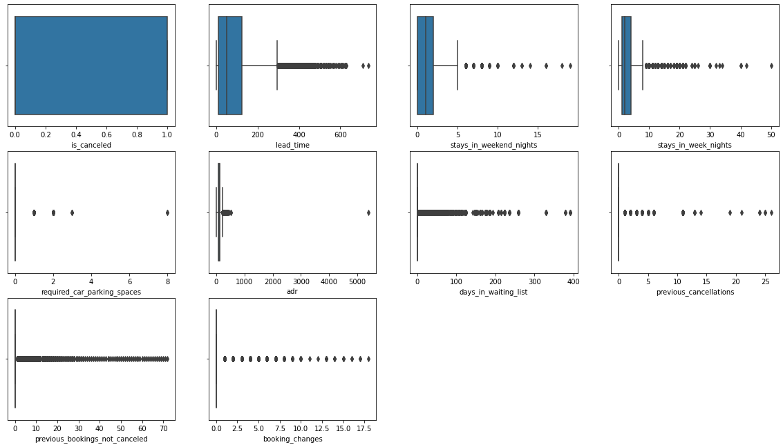
Cleaning of Dataset
As we can see that this dataset has many outliers and thus we can infer that this dataset is not very reliable.

Slide 12
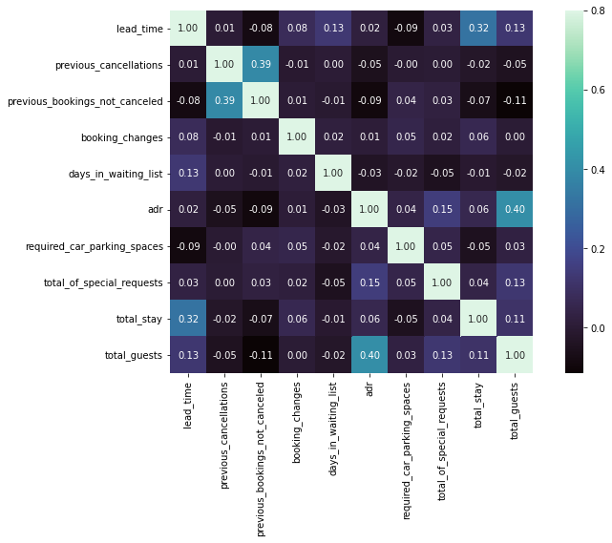
Data Visualization
Lead time and total stay have slight correlation. This means when people want to stay little longer they plan little before than actual arrival.
Total guests and average daily rate has some correlation. This means the when the number of guests increases, adr will also increase.

Slide 13
Data Visualization
Following insights are pulled out from this analysis:
What is the percentage of bookings in each hotel type?
From which country most guests come?
Which is the busiest month for hotels?
Which room type is in most demand ?
Which room type generate highest adr?
Which meal type is most preferred meal of customers?
How many booking were cancelled?
Which type of customers are most repeated?
Booking cancellation and Repeated guest

Slide 14
Data Visualization
10. Checking whether not getting allotted the same room type as demanded is the cause of cancellation of bookings?
11. Does not getting same room affects the adr.?
12. Which is the most common channel for booking hotels?
13. Which Distribution channel has highest no. of days in waiting list?
14. Which distribution channel has highest cancellation percentage?
15. Which Market segment has highest no. of days in waiting list?
Which is preferred stay length in each hotel?
17. Does lead time have effect on cancellation?

Slide 15
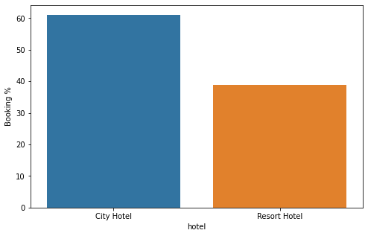
Data Visualization
Percentage of bookings in each hotel type
Around 60% bookings are for City Hotel and 40% are for Resort Hotel.

Slide 16
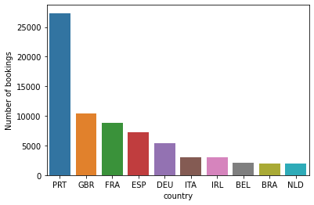
Data Visualization
From which country most guests come?
Portugal is the country from where most guests come. Around 31.36 % of guests come from Portugal, followed by Great Britain and France.

Slide 17
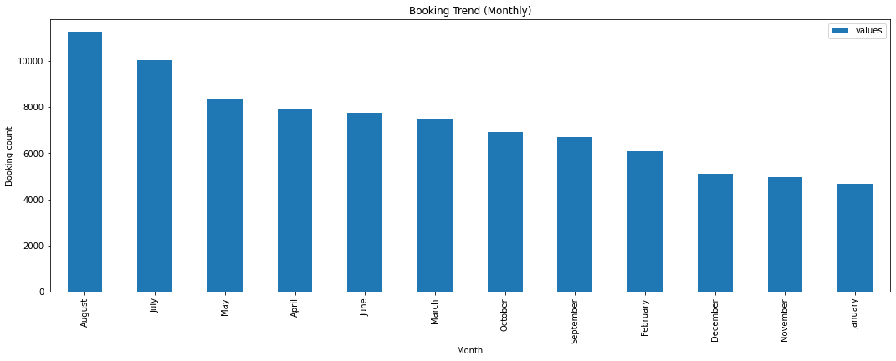
Data Visualization
Which is the busiest month for hotels?
As we can see most bookings were made from July to August. And the least bookings were made at the start and end of the year.

Slide 18
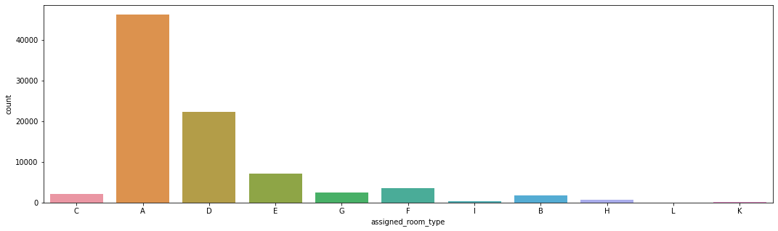
Data Visualization
Which room type is in most demand ?
Most demanded room type is ’A’. Hotel should increase room type A to increase the revenue.

Slide 19
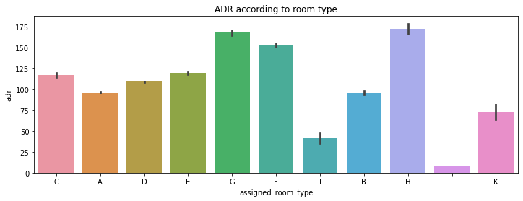
Data Visualization
Which room type generate highest adr?
Although room type A was of high demand and most booked, Highest revenue was produced by room type H followed by G. We can say that room type H and G are premium rooms.

Slide 20
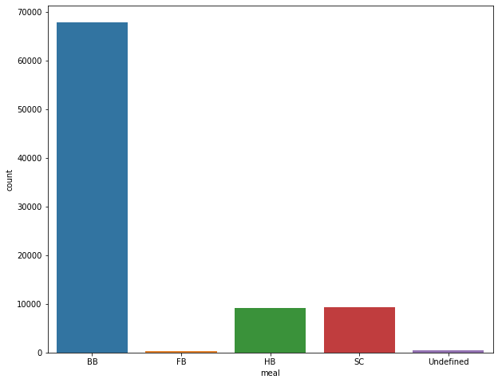
Data Visualization
Which meal type is most preferred meal of customers?
Most preferred meal type is BB i.e., Bed and breakfast

Slide 21
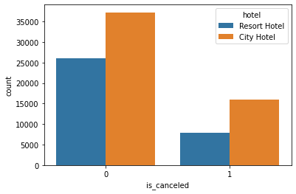
Data Visualization
How many booking were cancelled?
Around 8000 Resort Hotels and 16000 City Hotels got cancelled.

Slide 22
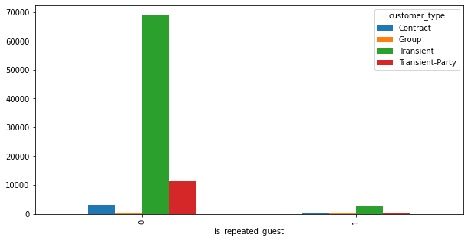
Data Visualization
Which type of customers are most repeated?
Here, we can see that the maximum number of repeated guests are "Transient type" i.e., the "Short-time customers"

Slide 23
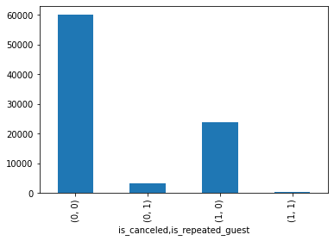
Data Visualization
Booking cancellation and Repeated guest
We see that when a hotel booking is cancelled and the customer is a repeated guest, the entries are almost '0', which means that repeated guest is very less likely to cancel his booking with the hotel.

Slide 24
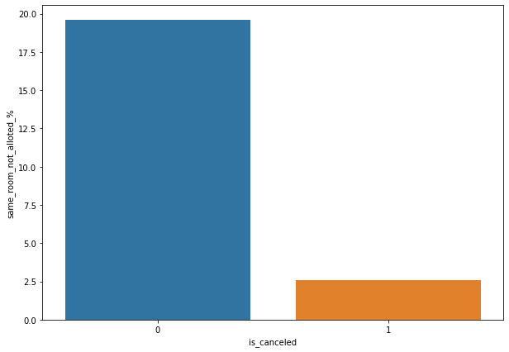
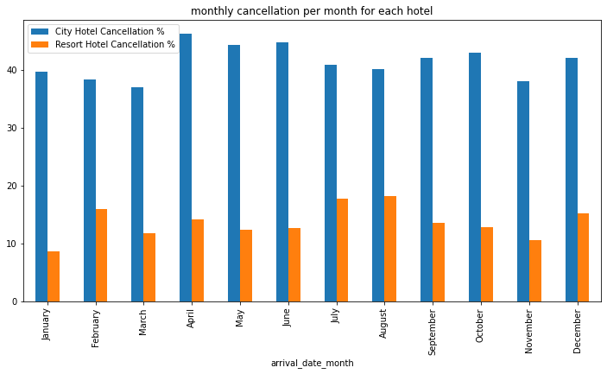
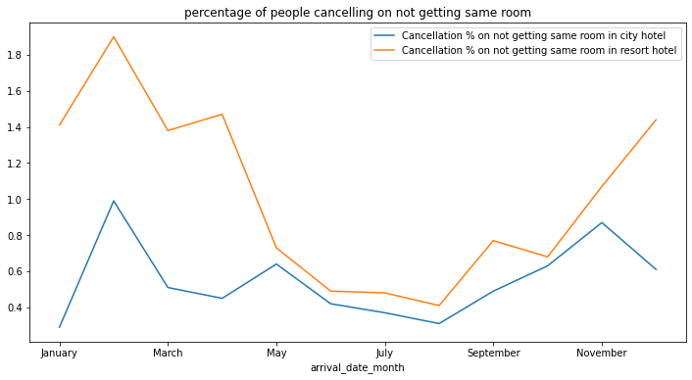
Checking whether not getting allotted the same room type as demanded is the cause of cancellation of booking?
Data Visualization
Here we see that not getting same room as demanded is not a case of room cancellation. A significant percentage of bookings are not cancelled even after getting different room as demanded.
we see that the cancellation are very less for resort and city hotels, which is quite significant. Guests are willing to keep their reservation even if they do not get the chosen accommodation.

Slide 25
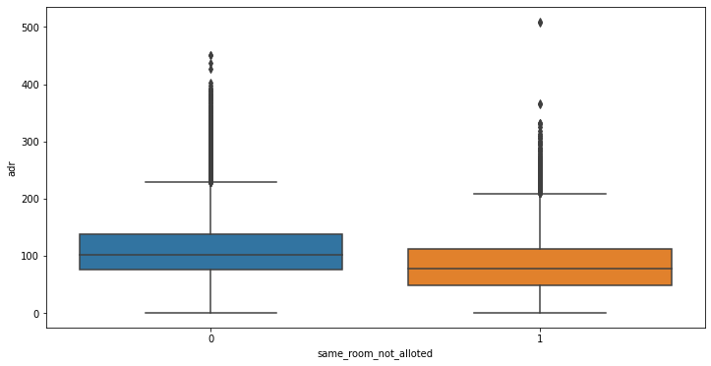
Data Visualization
Does not getting same room affects the adr?
Not getting same room do affects the adr, if a guest does not get the desired room, he will pay a bit less.

Slide 26
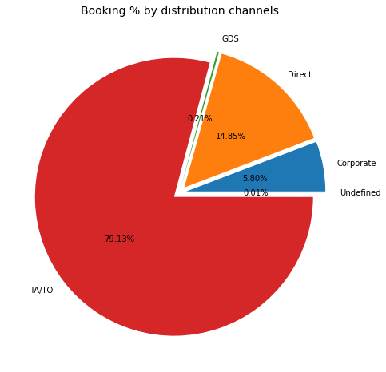
Data Visualization
Which is the most common channel for booking hotels?
Guests use different channels for making bookings out of which most preferred way is TA/TO (i.e., Travel Agents and Tour Operators)

Slide 27
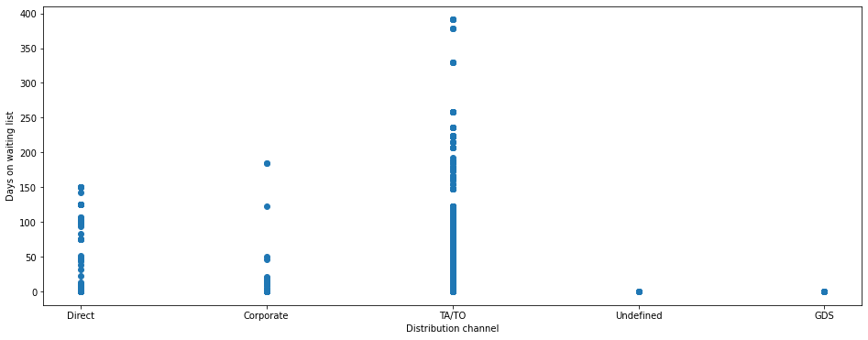
Data Visualization
Which Distribution channel has highest no. of days in waiting list?
We see that the 'Travel Agent' and 'Tour Operators' are the distribution channels for which the highest number of days are there on the waiting list.

Slide 28
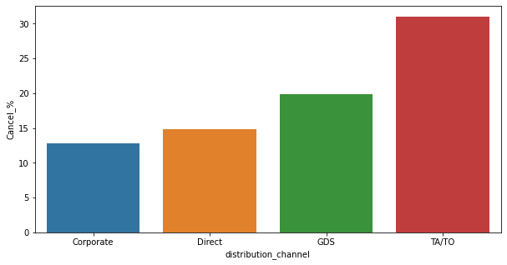
Data Visualization
Which distribution channel has highest cancellation percentage?
TA/TO has highest booking cancellation %. As a result, booking made through TA/TO are 30% more likely to be cancelled.

Slide 29
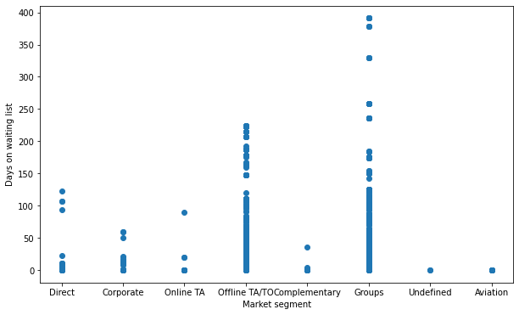
Data Visualization
Which Market segment has least no. of days in waiting list?
Here, we see that Aviation industry has the minimum number of days on the waiting list. The reason for this could be that when a flight has to land at the location, it has to provide immediate accommodation to all of its working staff such as pilots and air hostages therefore they do not entertain hotels that have a long waiting list. So, in general, the hotel management sees to it that their needs are satisfied immediately and that they have almost no days on the waiting list.

Slide 30
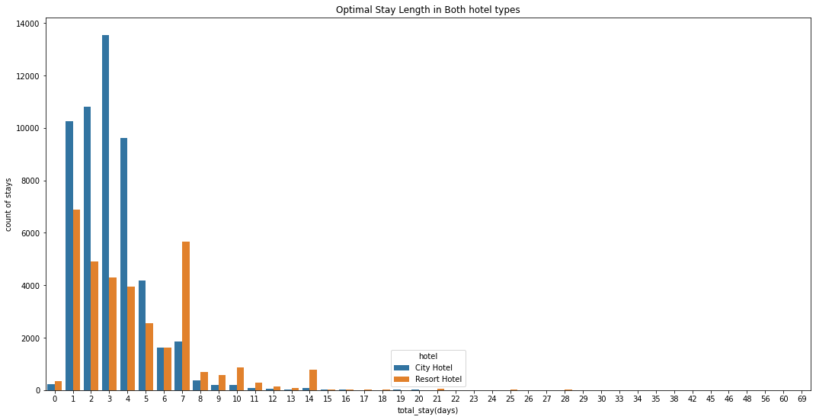
Data Visualization
Which is preferred stay length in each hotel?
Most people prefer to stay in hotels for at least 5 days in both types of hotel. However, people tend to stay longer at resort hotels.

Slide 31
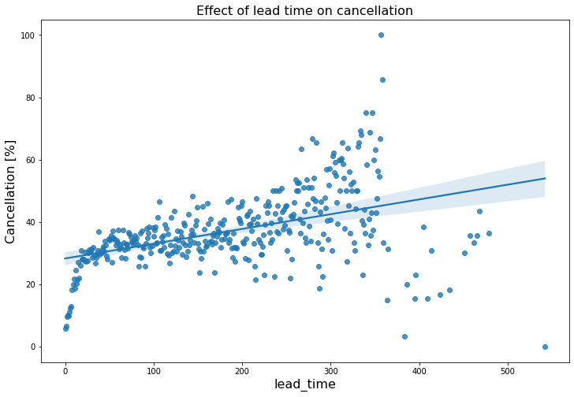
Data Visualization
Does lead time have effect on cancellation?
We see that the Effect of Lead time on Cancelation is POSITIVE which means that as the lead time increases, so does the number of cancelation.

Slide 32
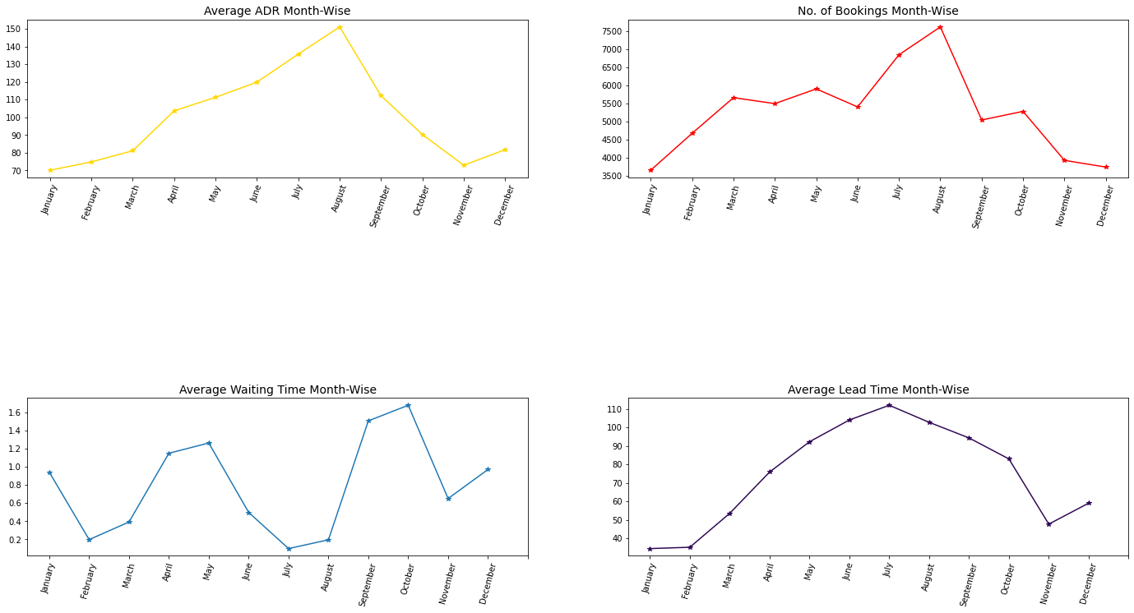
Data Visualization
Month-wise Analysis
When compared to previous months, we can see that the price and number of bookings are reduced from October to February. During this time, the average lead time is also very low.
The only concern is the waiting time, which is slightly longer from September to October, whereas the waiting time is the lowest and the price is the highest in July and August.
So the best time to book a hotel would be between October to February to get cheaper price and some privacy.

Slide 33
Inferences
The most popular hotel type is ‘City hotel’ which is preferred by 61.07% of total visitors.
96.15% of guests were not repeated guests.
27.08% customers have cancelled their booking.
Market was widely captured by distribution channels such as TA or TO, especially “Online TA” which captured 59% percent of the market.
Around 53% customers were assigned A room type and 65% has reserved it. This also indicates the fact that room type A is in higher demand.
Almost 82.4% of customers are transient, with very few booking as a group.

Slide 34
Conclusion
Higher lead time has higher chance of cancellation.
July-August are the busiest and most profitable months for both the hotels.
The best time to book a hotel would be between October to February to get for cheaper price.
Most people prefer to stay in the hotels for upto five days in both types of hotel. However, people tend to stay longer at resort
hotels.
5. Maximum number of repeated guests are "Transient type" i.e., the "Short-time customers"
City hotels receive around 60% of bookings, while Resort hotels receive 40%, hence city hotels are busier than Resort hotels.
City hotel’s total adr is slightly higher than Resort hotel’s.
Most of the guests were from European countries, with the most coming from Portugal followed by Great Britain and France.
Guests use different channels for making bookings out of which most preferred way is TA/TO.
Almost 30% of bookings via TA/TO are cancelled.
Bookings are not affected if they do not receive the same room as reserved. Although different room allotment does lessen the adr.

Slide 35

.

